Slide 1


ScreenSense: Kids’ Screentime Visualisation
A data-driven look at kids’ digital habits
Internship Report
Presented by: Haripriya Mahajan

Slide 2
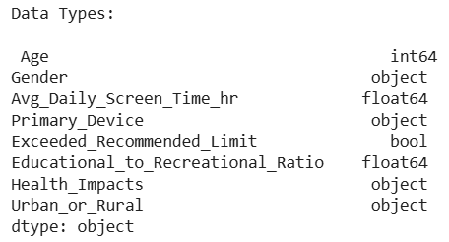
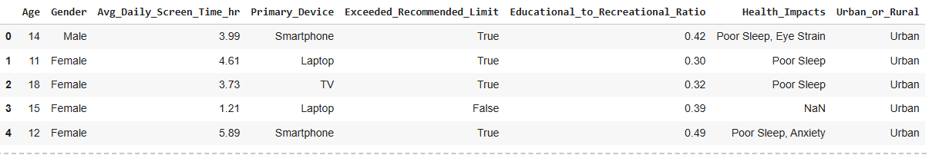
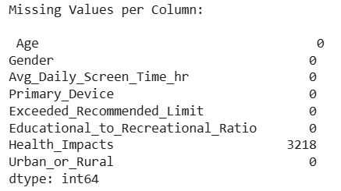
Milestone 1: Data Foundation and Cleaning
Week 1: Project Initialization and Dataset Setup
The dataset was explored to understand its fields, size, and what it reveals about kids’ screen habits.
Early checks focused on column types, inconsistent labels, and missing values.
These observations shaped the project plan: clean the data, build core visuals, compare key segments, and identify deeper usage patterns.
Raw Dataset

Slide 3
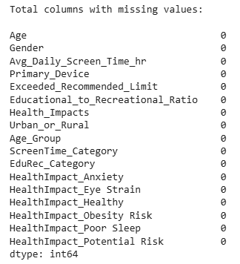
Week 2: Preprocessing and Feature Engineering
Missing values in Health Impact column were handled and inconsistent device/activity labels were cleaned.
One-Hot encoding was used for comma-separated values in Health Impact column.
New fields were created, including age groups, weekday/weekend, screen-time categories, and Educational/Recreational ratios.
Standardization ensured a consistent, analysis-ready dataset.
Age Group Column Kids: 8-11
Pre-Teens: 12-14
Teens: 15-18
Edu-Rec Category
Mostly Recreational: 0.3-0.4
Balanced Usage: 0.4-0.5
Mostly Educational: 0.5-0.6
Screen-time Categories
Low Usage: 0-2 hr
Moderate Usage: 2-5 hr
High Usage: 2-8 hr
Very High Usage: 8-24 hr
Day Type
Weekday: Low or Moderate Usage
Weekend: High or Very High Usage

Slide 4

Milestone 2: Visual Exploration and Topic Trends
Week 3: Univariate and Bivariate Visual Analysis
Univariate Analysis
Looked at individual variables like daily screen hours, device types, activity categories, and age groups.
Identified how screen time is distributed across the dataset, including the presence of high-usage clusters.
Saw which devices and screen-time categories were most common overall.
Bivariate Analysis
Compared age with screen hours and found clear differences: pre-teens and teens show the highest usage.
Checked gender and location differences, which showed minimal variation across most metrics.
Observed a strong split between weekday and weekend usage, with weekends showing noticeably higher screen hours.

Slide 5
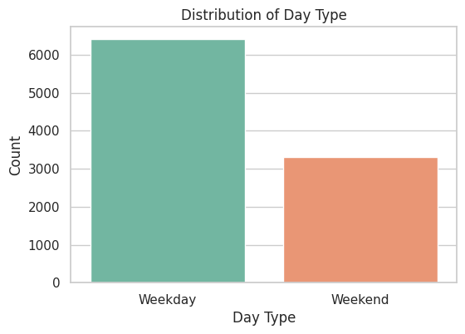
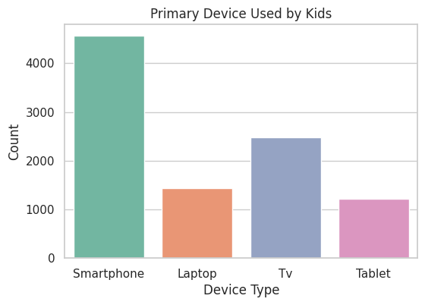
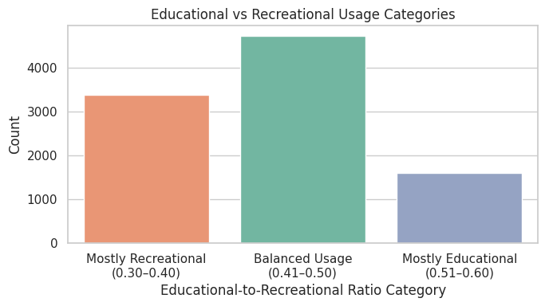
Week 4: Device/Activity and Weekday/Weekend Analysis
Device usage patterns showed kids mainly use TVs, pre-teens rely on laptops and smartphones, and teens use a mix of devices.
Activity categories highlighted a strong recreational share.
Weekend usage was significantly higher than weekday usage

Slide 6
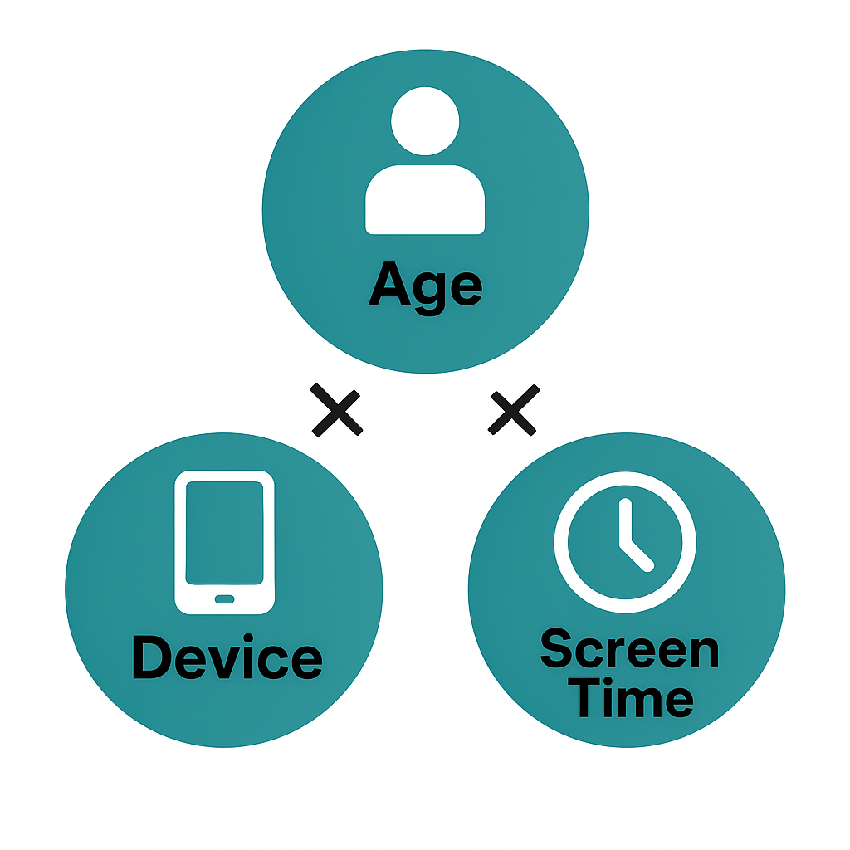
Milestone 3: Segment & Insight Deep-Dives
Week 5: Cohort and Segment Analysis
Cohorts such as Age × Device, Age × ScreenTime, and Device × ScreenTime revealed detailed usage clusters.
Heatmaps highlighted heavy-use groups, with pre-teens and kids often at the top.
Gender differences were small, while location showed differences mainly in health symptoms.
Week 6: Seasonal/Calendar or Habit Patterns
With no date column, analysis focused on behaviour patterns instead of seasonality.
Day-Type and ScreenTime_Category fields showed recurring habits and consistent high-use categories.
Insights confirmed stable patterns across user segments.

Slide 7
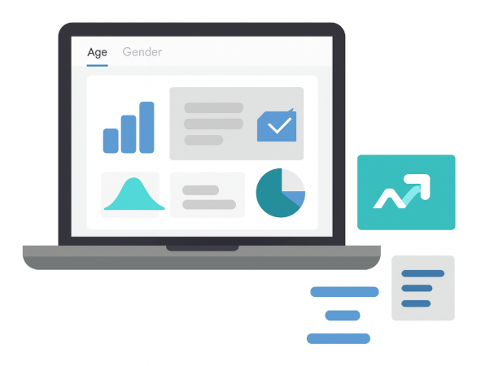
Milestone 4: Report and Presentation
Week 7: Visual Report or Dashboard Preparation
A Power BI dashboard was built with filters for age, gender, and location.
Key visuals included device mix, usage distribution, day-type patterns, and cohort summaries.
Week 8: Documentation and Final Presentation
Insights were consolidated into a final report and slide deck.
The presentation followed a clear flow: Who uses screens the most? → How are they using screens? → What are the consequences?→ Who is at the highest risk?

Slide 8
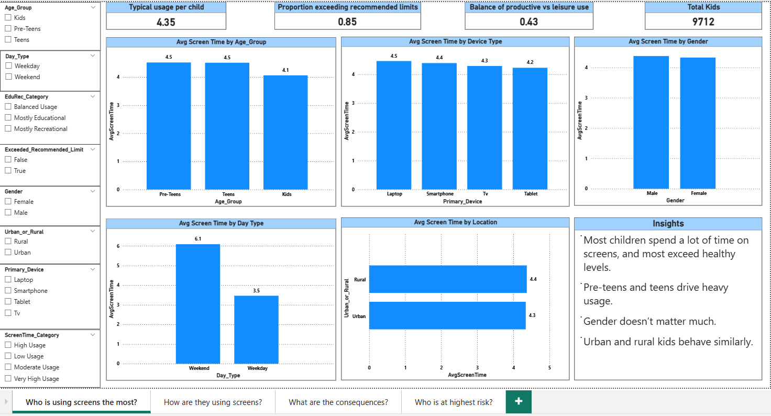
Final Dashboard
Who is using screens the most?

Slide 9
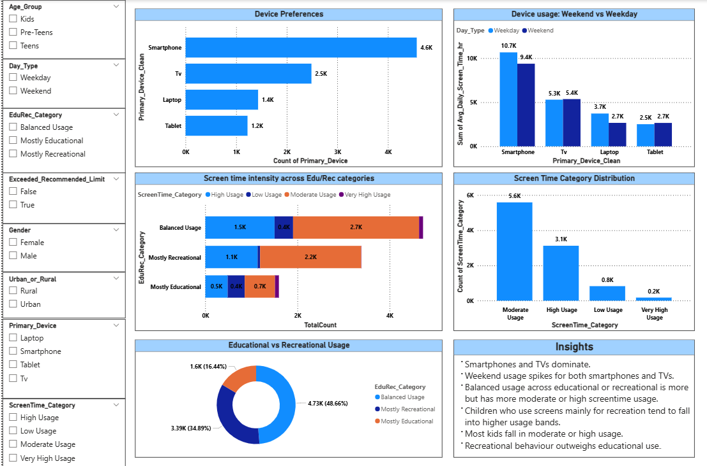
How are they using screens?

Slide 10
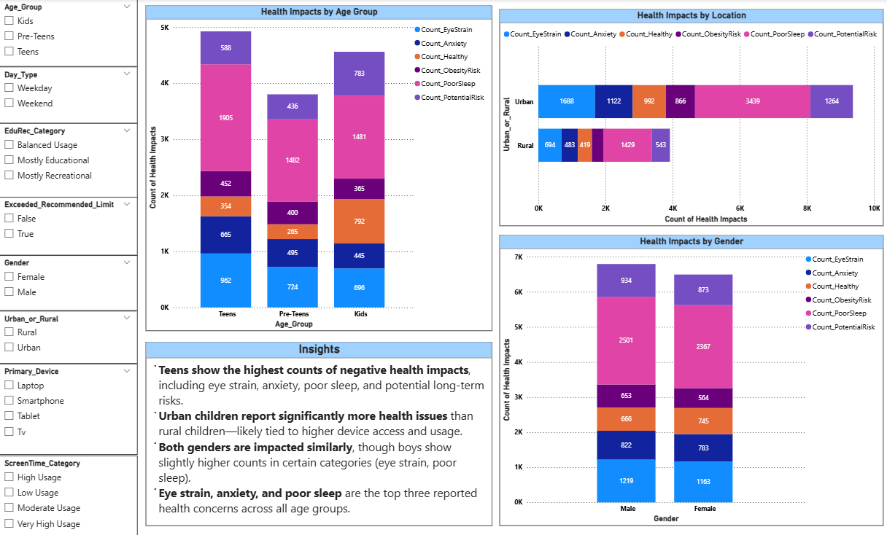
What are the consequences?

Slide 11
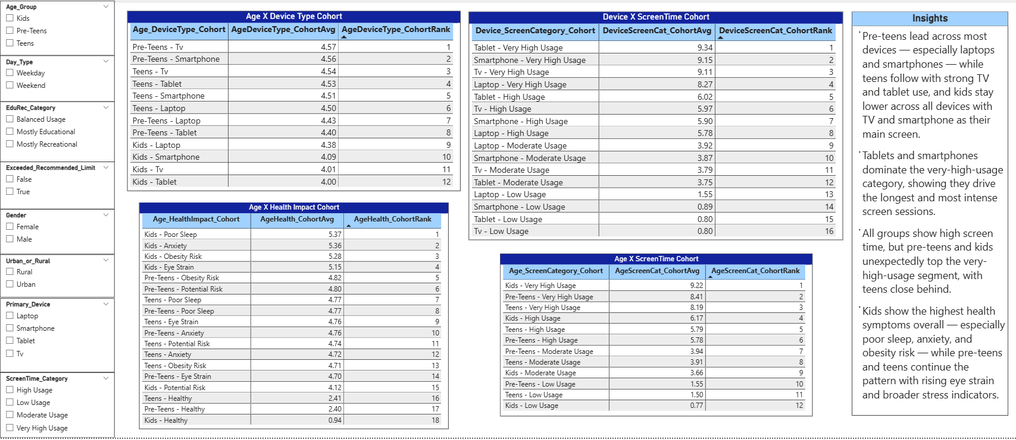
Who is at the highest risk?

Slide 12
Thank You!

